Slide 1
Why You Should Be an Open Source Contributor and How to Get Started
By Lauren Stephenson

Slide 2



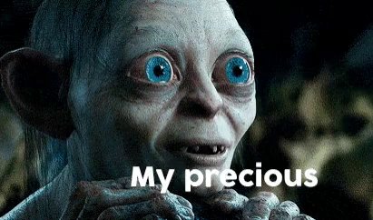
What is Open Source?
Notes:
When software is open source, it means that anybody can look at the code. Anybody can see how it was made, and they can often even make their own copy of the entire project. They can use their copy however they want, and change the code if they want. Open source projects are like rooms with unlocked glass doors. You can look inside and interact with everything. This is different from proprietary software, whose code cannot be viewed openly by the public. You can think of that like the company keeping a locked safe with the code for their software, only available to people who have access to it. Neither method is inherently better or worse, they’re just different approaches with their own pros and cons.

Slide 3
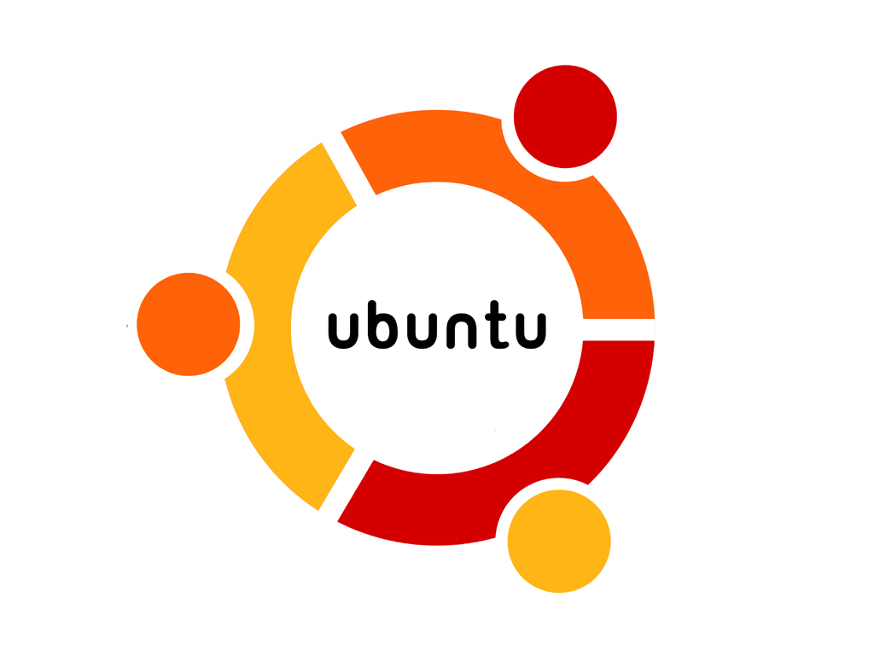




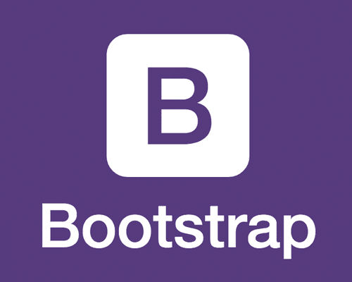



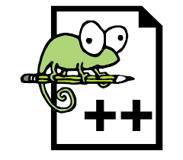



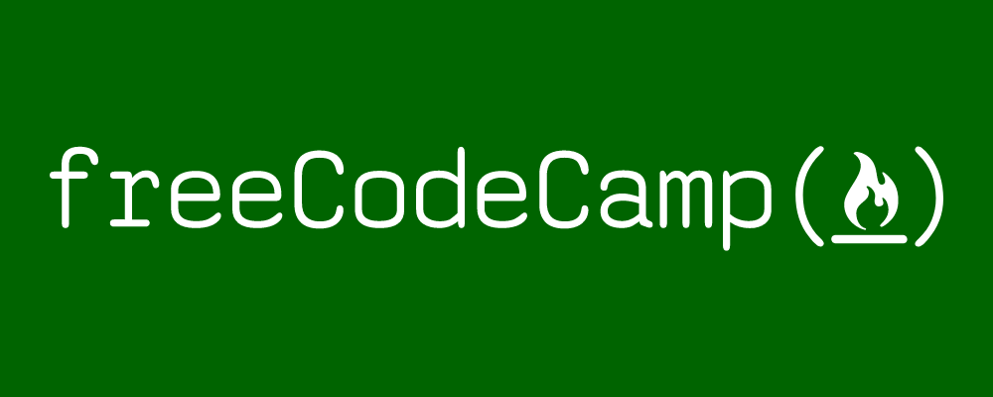
Examples of Open Source Projects
Notes:
Here are some examples of open source projects. You can view most or all of the code for these projects. One thing to note is that Reddit, while it was very open source up until 2017, is increasingly becoming closed source. However, they do plan to continue contributing to open source as a company and releasing open source tools.

Slide 4

Who uses Open Source software?
Many people, and most companies! Most studies estimate that anywhere from 78% to 98% of companies use open source software.
Notes:
Pretty much everyone! It is only increasing in popularity.

Slide 5

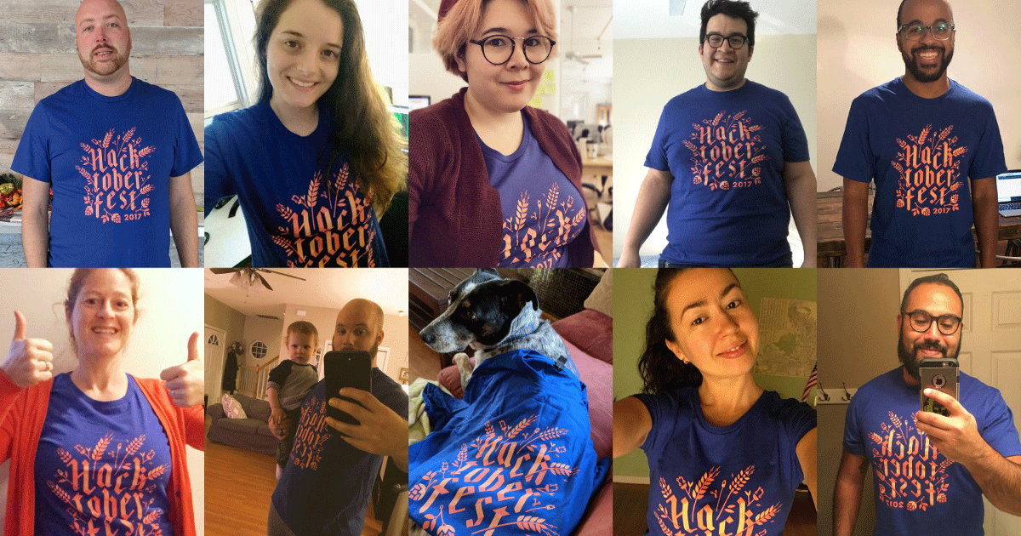
What You Can Get Out of Contributing to Open Source software
Learn to code
Increase confidence
Experience collaborating with others
Become a better programmer
Build something and create an impact
Stand out amongst other job applicants
Experience joy and satisfaction
Free t-shirt

Slide 6

Notes:
hacktoberfest.digitalocean.com

Slide 7
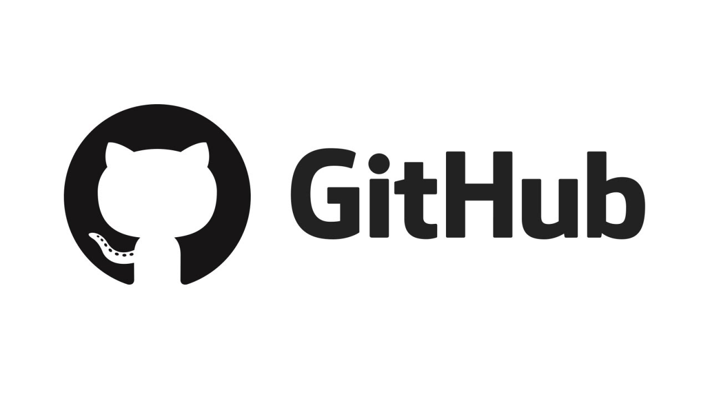


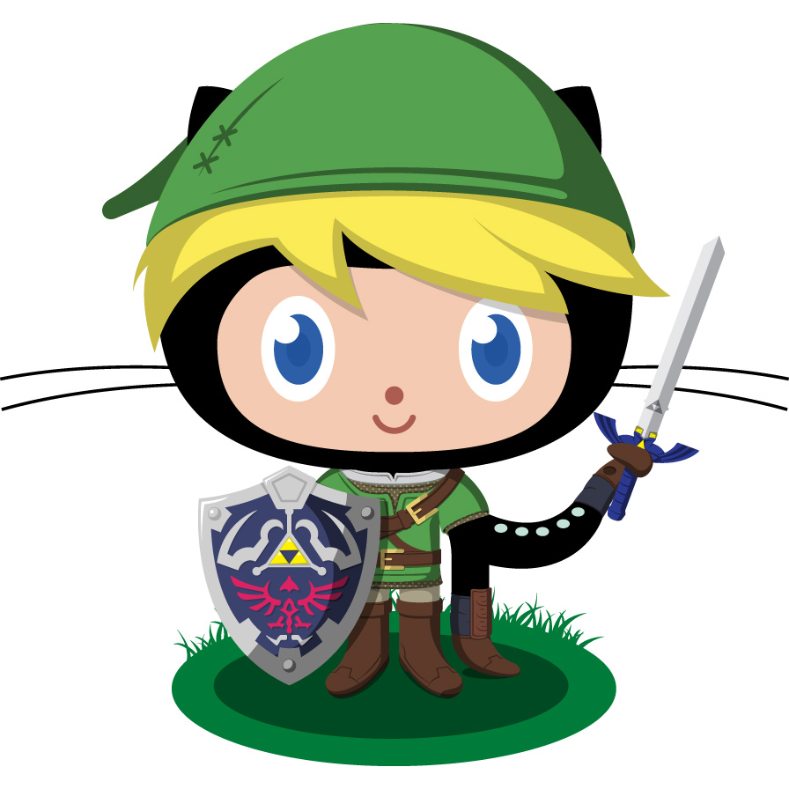
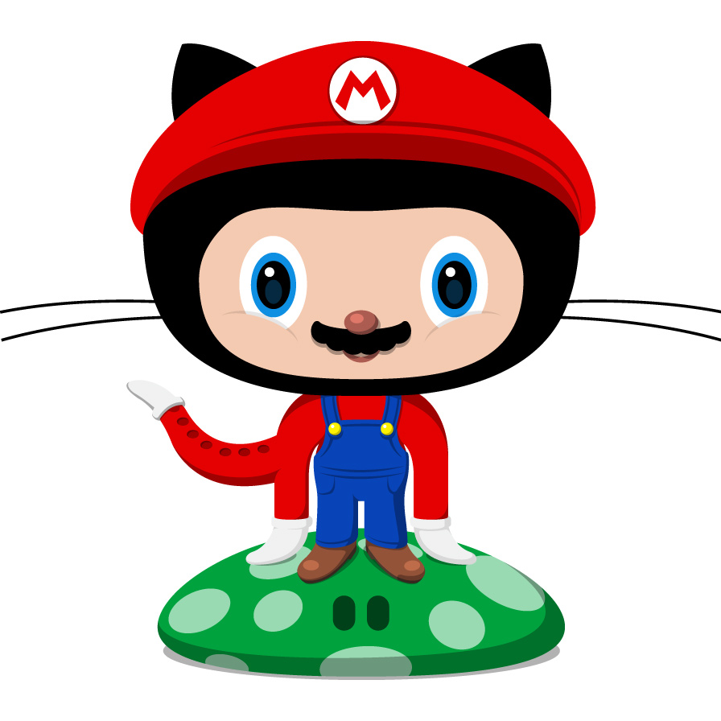



Where to start?
Notes:
Best website for open source software is GitHub. It’s where you and anyone else can upload their coding projects for everyone else to see. When you help someone else’s public GitHub project, you are contributing to open source. If you upload your own project to GitHub and make it public, then your project is open source! Projects may also have licenses associated with them, so it can be good to look at those and see if there are any special rules regarding the project. In most cases you should be fine if you are acting with good ethics.

Slide 8
Finding a Project on GitHub
There are over 100 million repositories on GitHub! With 1.6 new repositories created every second, the options are basically limitless. So how do you choose?
Notes:
You can find all kinds of tips online about how to find your first project to contribute to. The following slides are my two recommended strategies.

Slide 9
Strategy #1 - Pick a “practice” project
Ideal choice if you have never made a pull request to another GitHub project before.
Two Practice Projects:
https://github.com/firstcontributions/first-contributions
https://github.com/twilio-labs/open-pixel-art

Slide 10
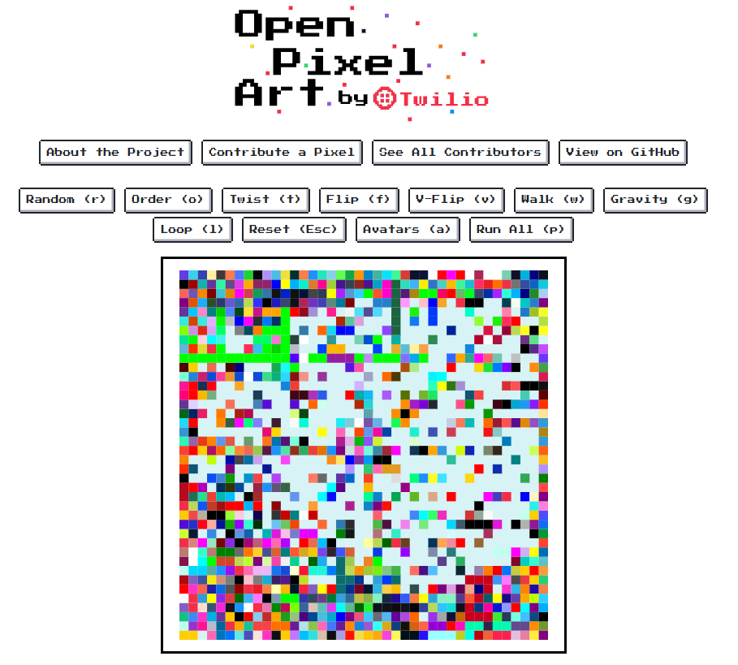
Notes:
This is the 2nd practice project. Anyone can add a pixel to the canvas as a simple and fun way to gain experience contributing to open source!

Slide 11
Strategy #2 - Find interesting projects
Best long-term strategy.
Look for projects that are related to something you are interested in. Contributing to something you use or appreciate is the most fun.
Keep an eye out for these and “star” them on GitHub as a way of bookmarking them. Over time, you’ll have a unique list of interesting projects you can contribute to!

Slide 12
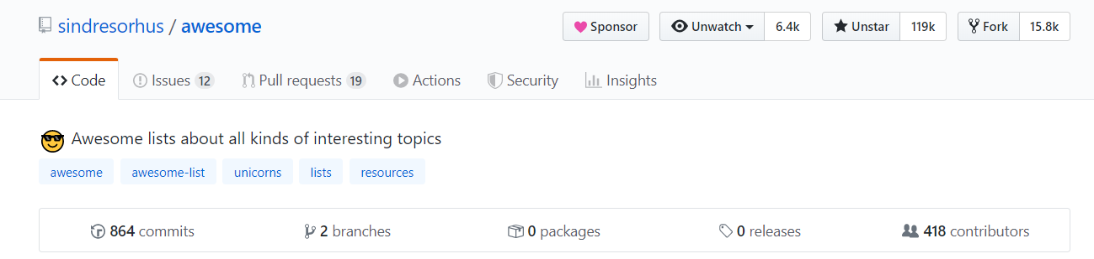
Example: Awesome List
Here is one of the items on the Awesome List, called “Awesome for Beginners”: https://github.com/MunGell/awesome-for-beginners

Slide 13
More Beginner-Friendly Projects
Here is a great resource for finding beginner-friendly projects: https://www.firsttimersonly.com/

Slide 14
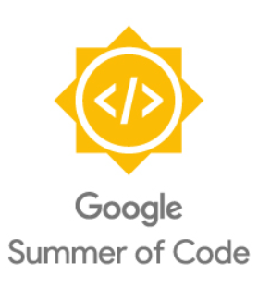
Opportunity: Google Summer of Code
Great opportunity to get paid to explore open source!
“Google Summer of Code is a global program focused on bringing more student developers into open source software development. Students work with an open source organization on a 3 month programming project during their break from school.”
Find out more here: https://summerofcode.withgoogle.com/

Slide 15
Figuring out what to contribute exactly
Find typos in the README or in code comments
Improve wording in the README or in code comments
Create the README if a project does not have one yet
Search a project’s “Issues” for ideas on what to contribute
Notes:
I recommend starting to contribute by improving documentation, rather than starting off by coding. It’s a lower barrier to entry and helps you get familiar with the project. Plus, there is always a need for good documentation.

Slide 16
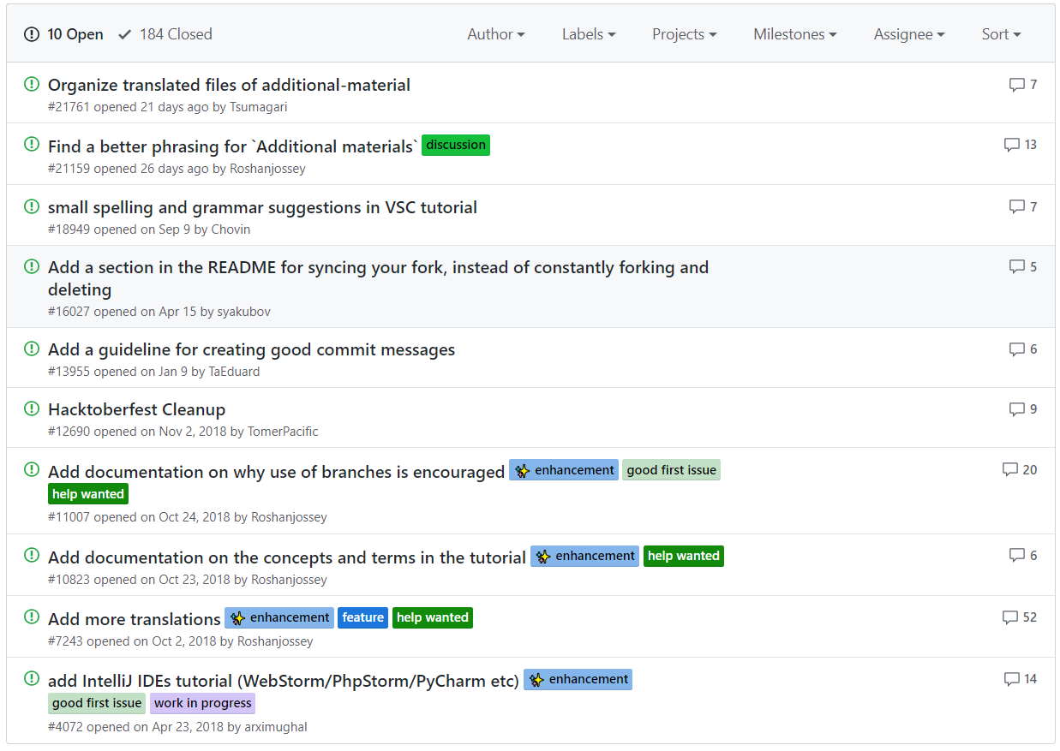
Notes:
Keep an eye out for labels like “beginner-friendly”, “good first issue”, “first timers only”, etc. You can even search for specific labels on the GitHub search bar.

Slide 17
How to make the contribution
Download the project onto your computer
Make the changes on your copy of the project
Create a “pull request” to add your contribution to the project
Notes:
Specific instructions can be found in the “first contributions” project mentioned on a previous slide. Here is that same link: https://github.com/firstcontributions/first-contributions

Slide 18
How to get an employer to notice?
Put your GitHub account link on your resume, Linkedin, Twitter, etc.
Be prepared to talk about your projects and/or open source contributions during your interview
Notes:
GitHub is not a replacement for a portfolio, but is definitely good to show employers if you don’t have a portfolio built out already. Recruiters probably won’t look at the projects, but hiring managers might. Also, it’s okay that your code isn’t perfect. Hiring managers aren’t looking for perfection. it’s just interesting for them to see things you’ve worked on and can be a good talking point for either party to bring up during interviews.

Slide 19



Thank you!
Lauren Stephenson
CompSciLauren@gmail.com
@CompSciLauren
Notes:
Thank you! Feel free to contact me anytime.

